Slide 1
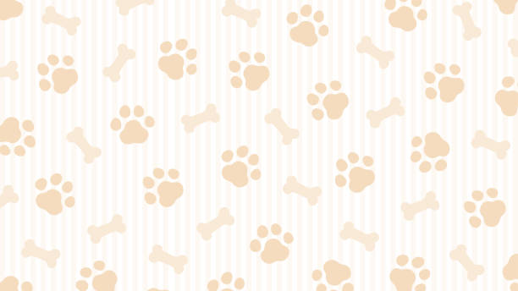
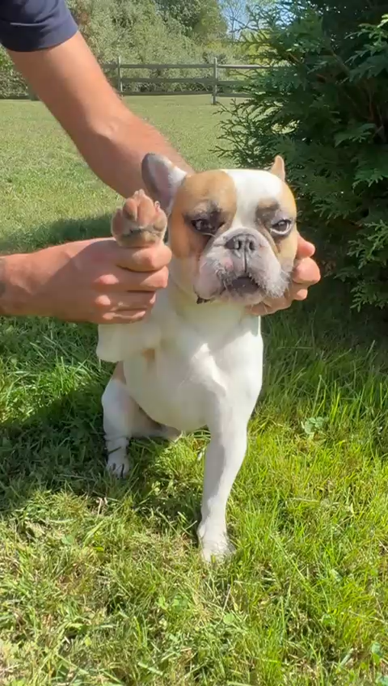
Hi! I’m Coco
And today I would like to introduce you to…

Slide 2
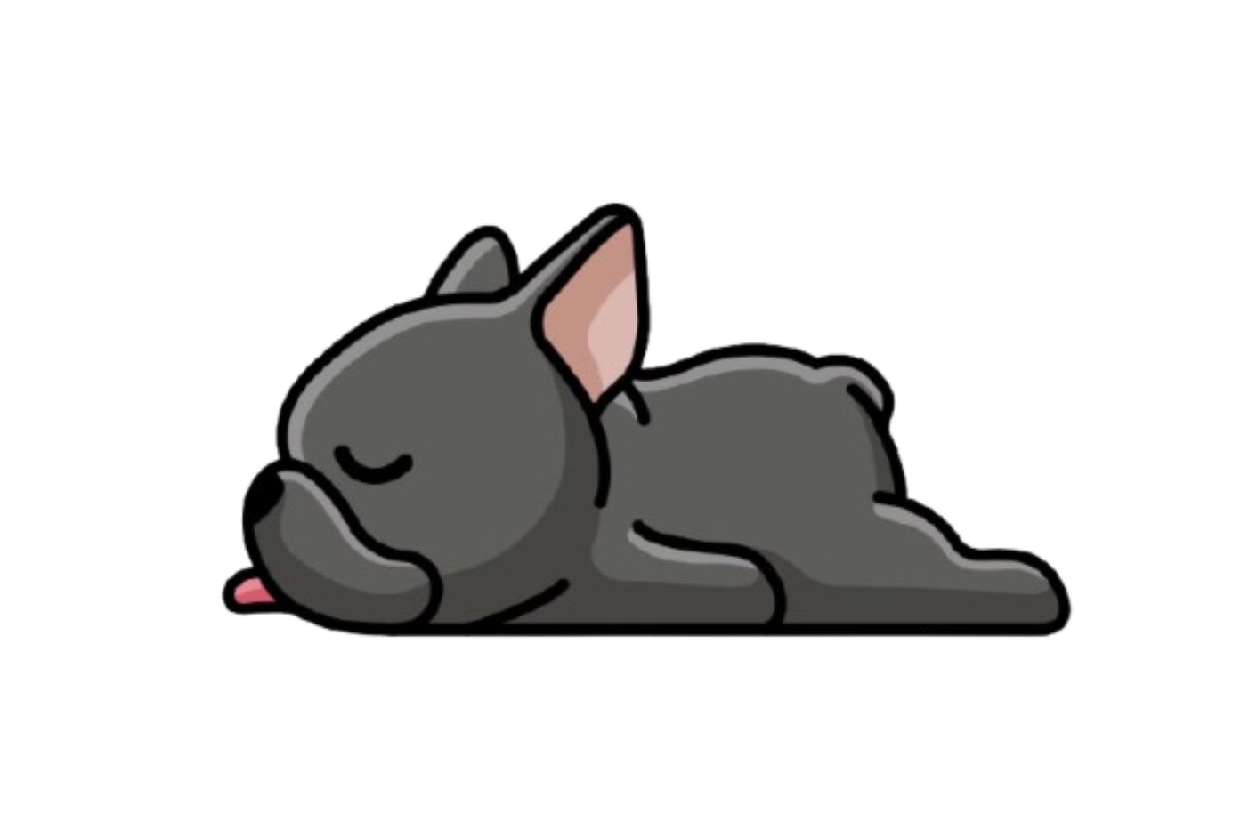
SnootZzz

Slide 3
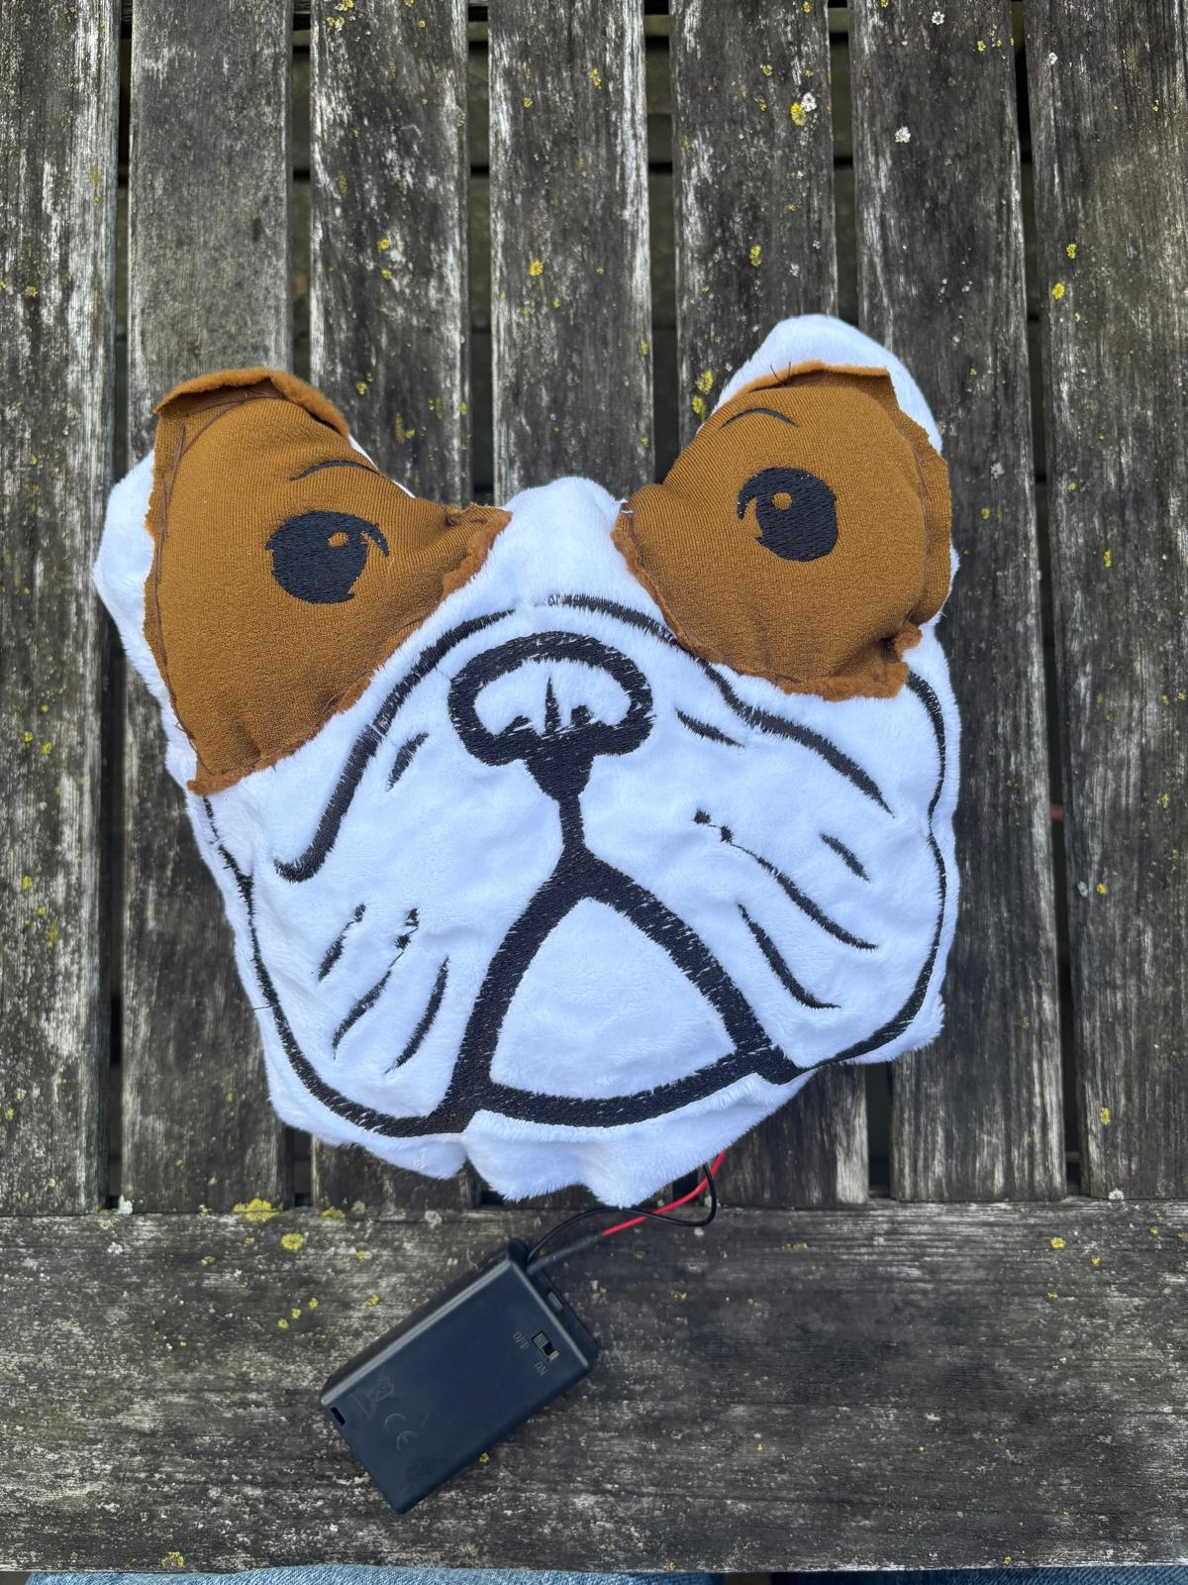
SnootZzz is a plushie that was created to look like me. This plushie, when turned on, mimics my snoring pattern. Not all of us get to spend time with our dogs all the time. Having a plushie that looks and feels like me, not only reduces anxiety but reduces the human's "separation anxiety".

Slide 4
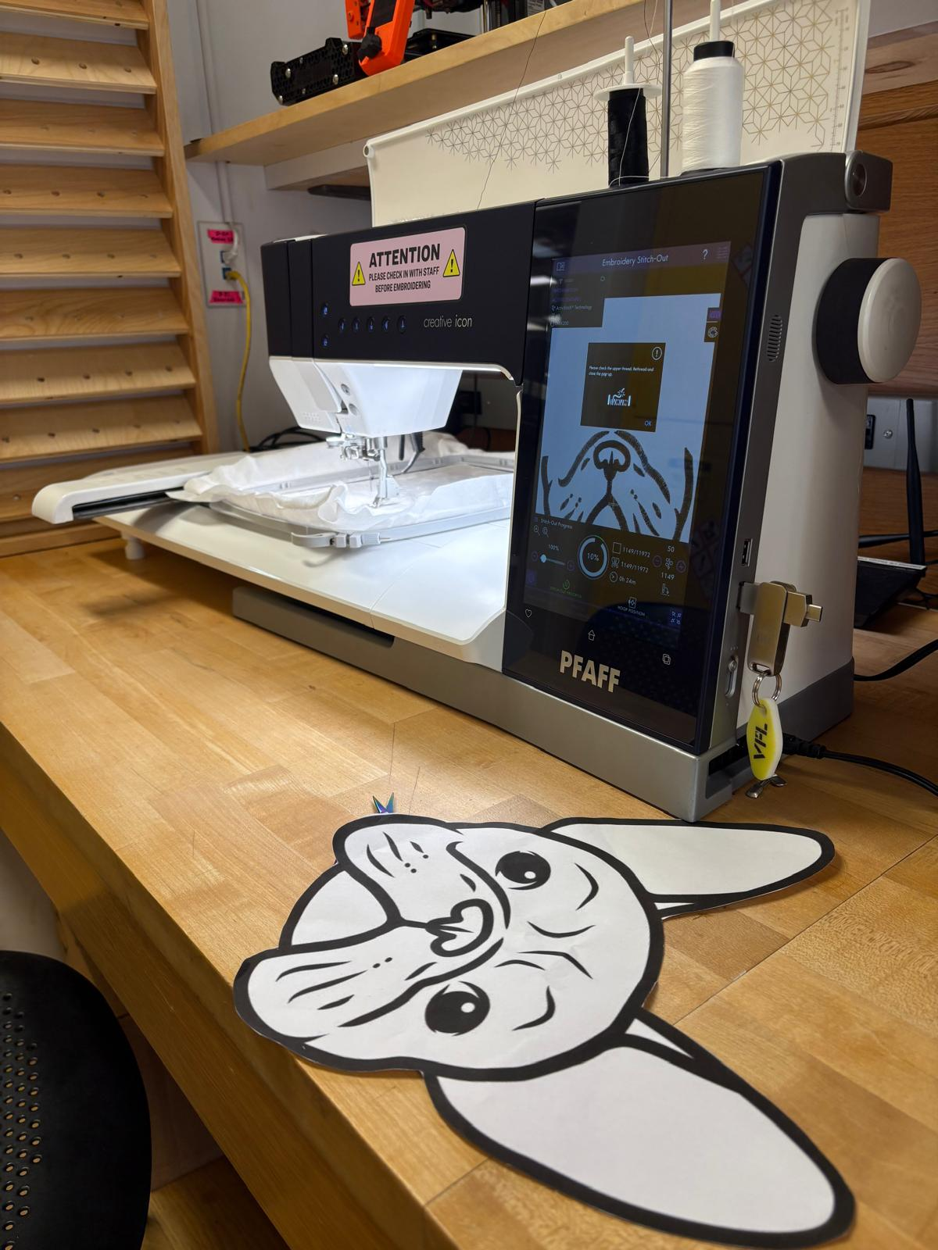
To bring me to life, these materials and parts were used:
Brown fleece
White fleece
White fabric
2 Yellow Leds
Resistors
Wires
Battery Pack
Digital Embroidery

Slide 5
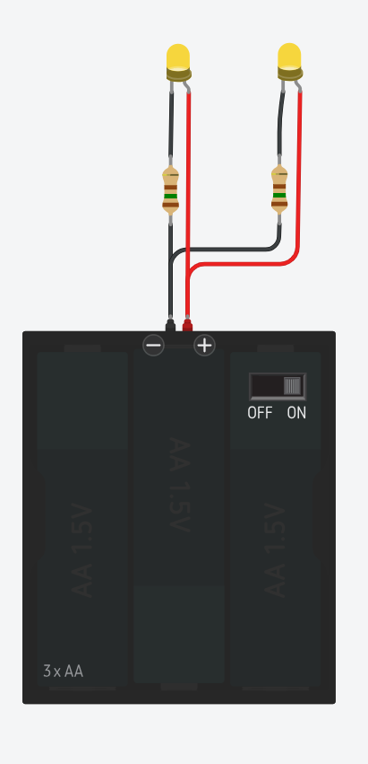
Circuit Diagram

Slide 6
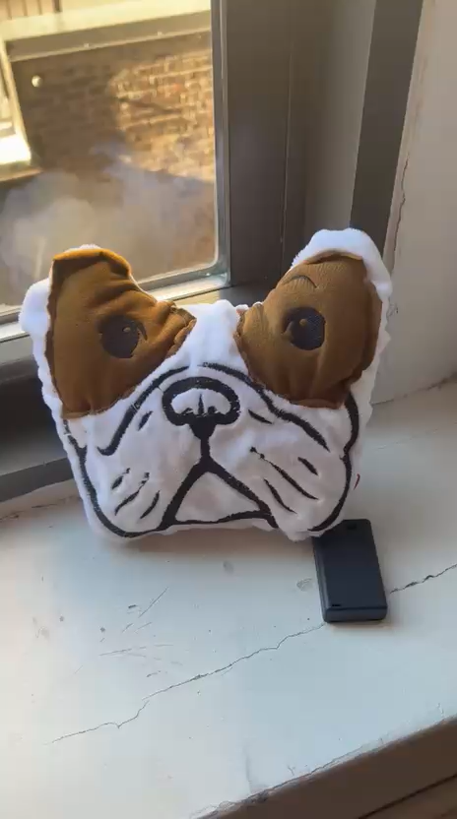
This journey was not easy. The digital embroidery machine was new to me and that took me some time to learn. If I were to recreate this plushie, I would make it bigger because I didn’t realize the embroidery and applique would make the ears disappear! Additionally, I would try to position the LEDS better and make it brighter.

Slide 7
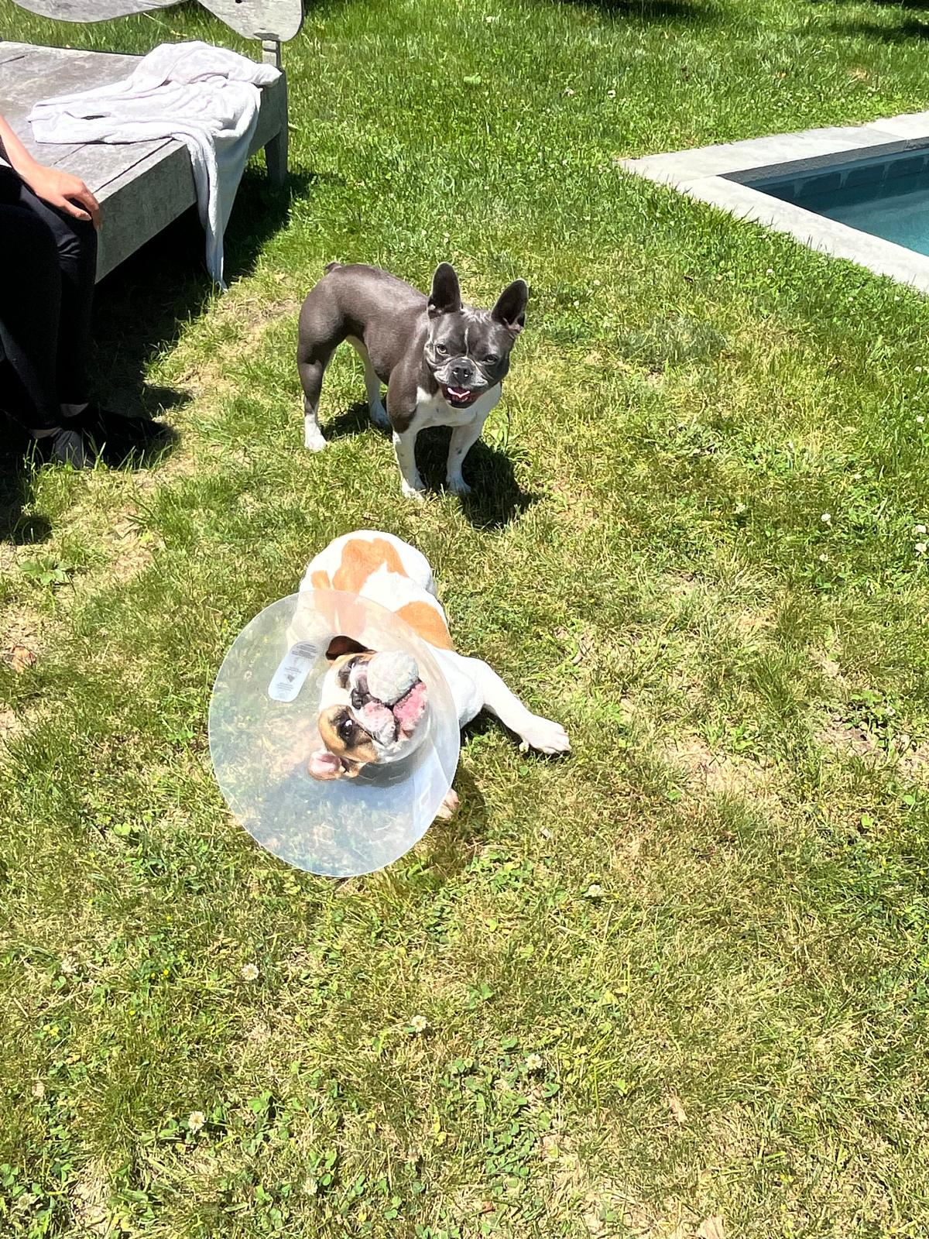
Woof Woof
(Dog for Thank You)

Slide 8
